Slide 1
Factor Analysis w/ R
Lead: Aishat Sadiq
Support: Jacob Grippen
F23 CCSS DSF

Slide 2
Learning Aims/outline
Understand the concept of factor analysis and its applications.
Understand the difference between exploratory factor analysis, principal components analysis, and confirmatory factor analysis
Learn how to perform factor analysis in R
EFA
CFA
Visualization

Slide 3
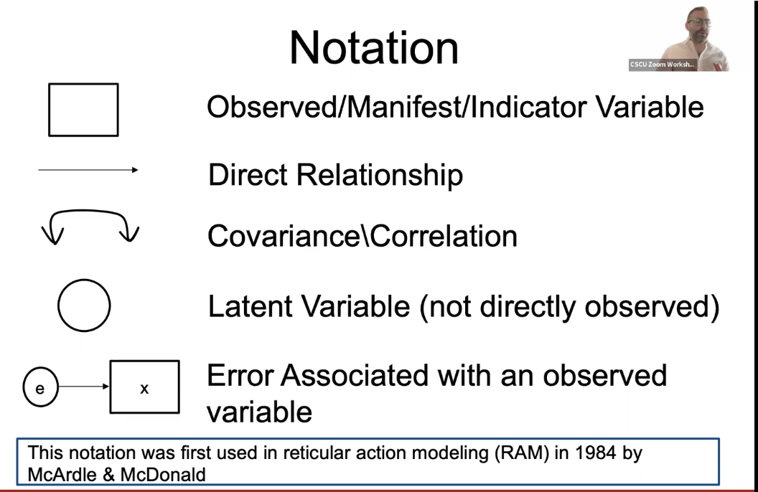

Slide 4
Vocabulary
Factor/Latent Variable
Orthogonal/Factor Rotation
Eigenvalues + Eigenfactors
Observed Variable
Items/Indicators
EFA
Dimension Reduction/PCA
CFA/SEM
Common Variance vs Unique Variance
Communality/Co-linearity

Slide 5
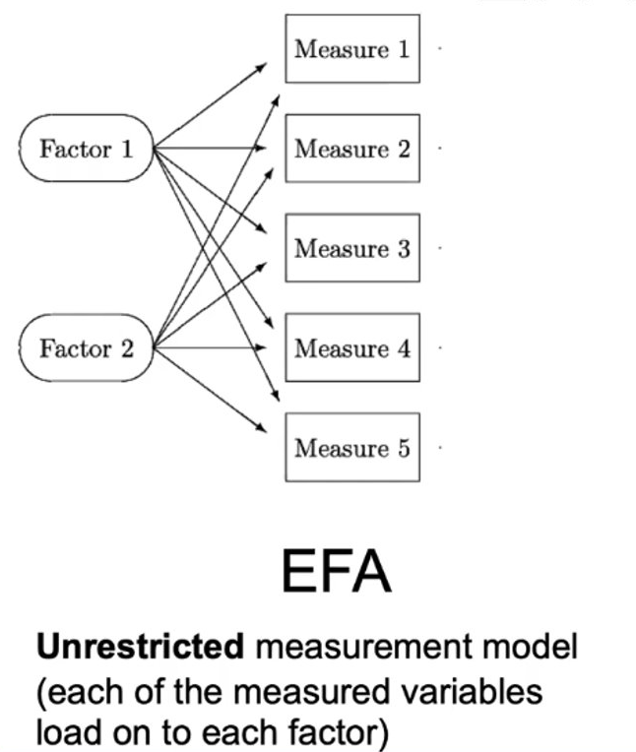
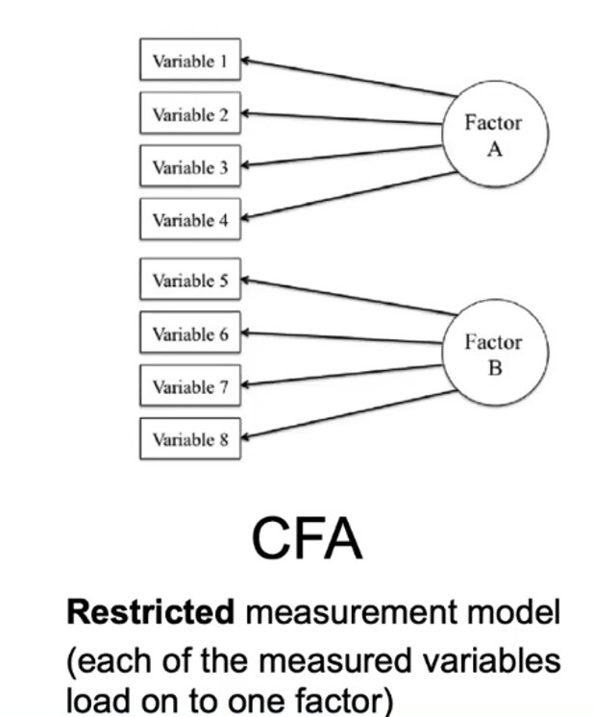
Types of Factor Analysis
EFA
CFA + SEM
Notes:
Discuss when to use each type in different scenarios.

Slide 6
Lavaan SEM Syntax
Before running our first factor analysis, here's the most frequently used syntax in lavaan:
~ predict, used for regression of observed outcome to observed predictors
=~ indicator, used for latent variable to observed indicator in factor analysis measurement models
~~ covariance
~1 intercept or mean (e.g., q01 ~ 1 estimates the mean of variable q01)
1* fixes parameter or loading to one
NA* frees parameter or loading (useful to override default marker method)
a* labels the parameter ‘a’, used for model constraints

Slide 7
Modeling Assumptions + Rules of Thumb
Large Data
N > 300
10-15 observations (N) per variable
Low collinearity = greater sample size req

Slide 8
Live Coding Demo

Slide 9
Steps
Fit a CFA model using the lavaan package
one factor three items
one factor three items, variance std
uncorrelated two factor solution
correlated two factor solution, marker method
Fit a EFA model using the psych package
determine number of factors
Extract (and rotate) factors

Slide 10
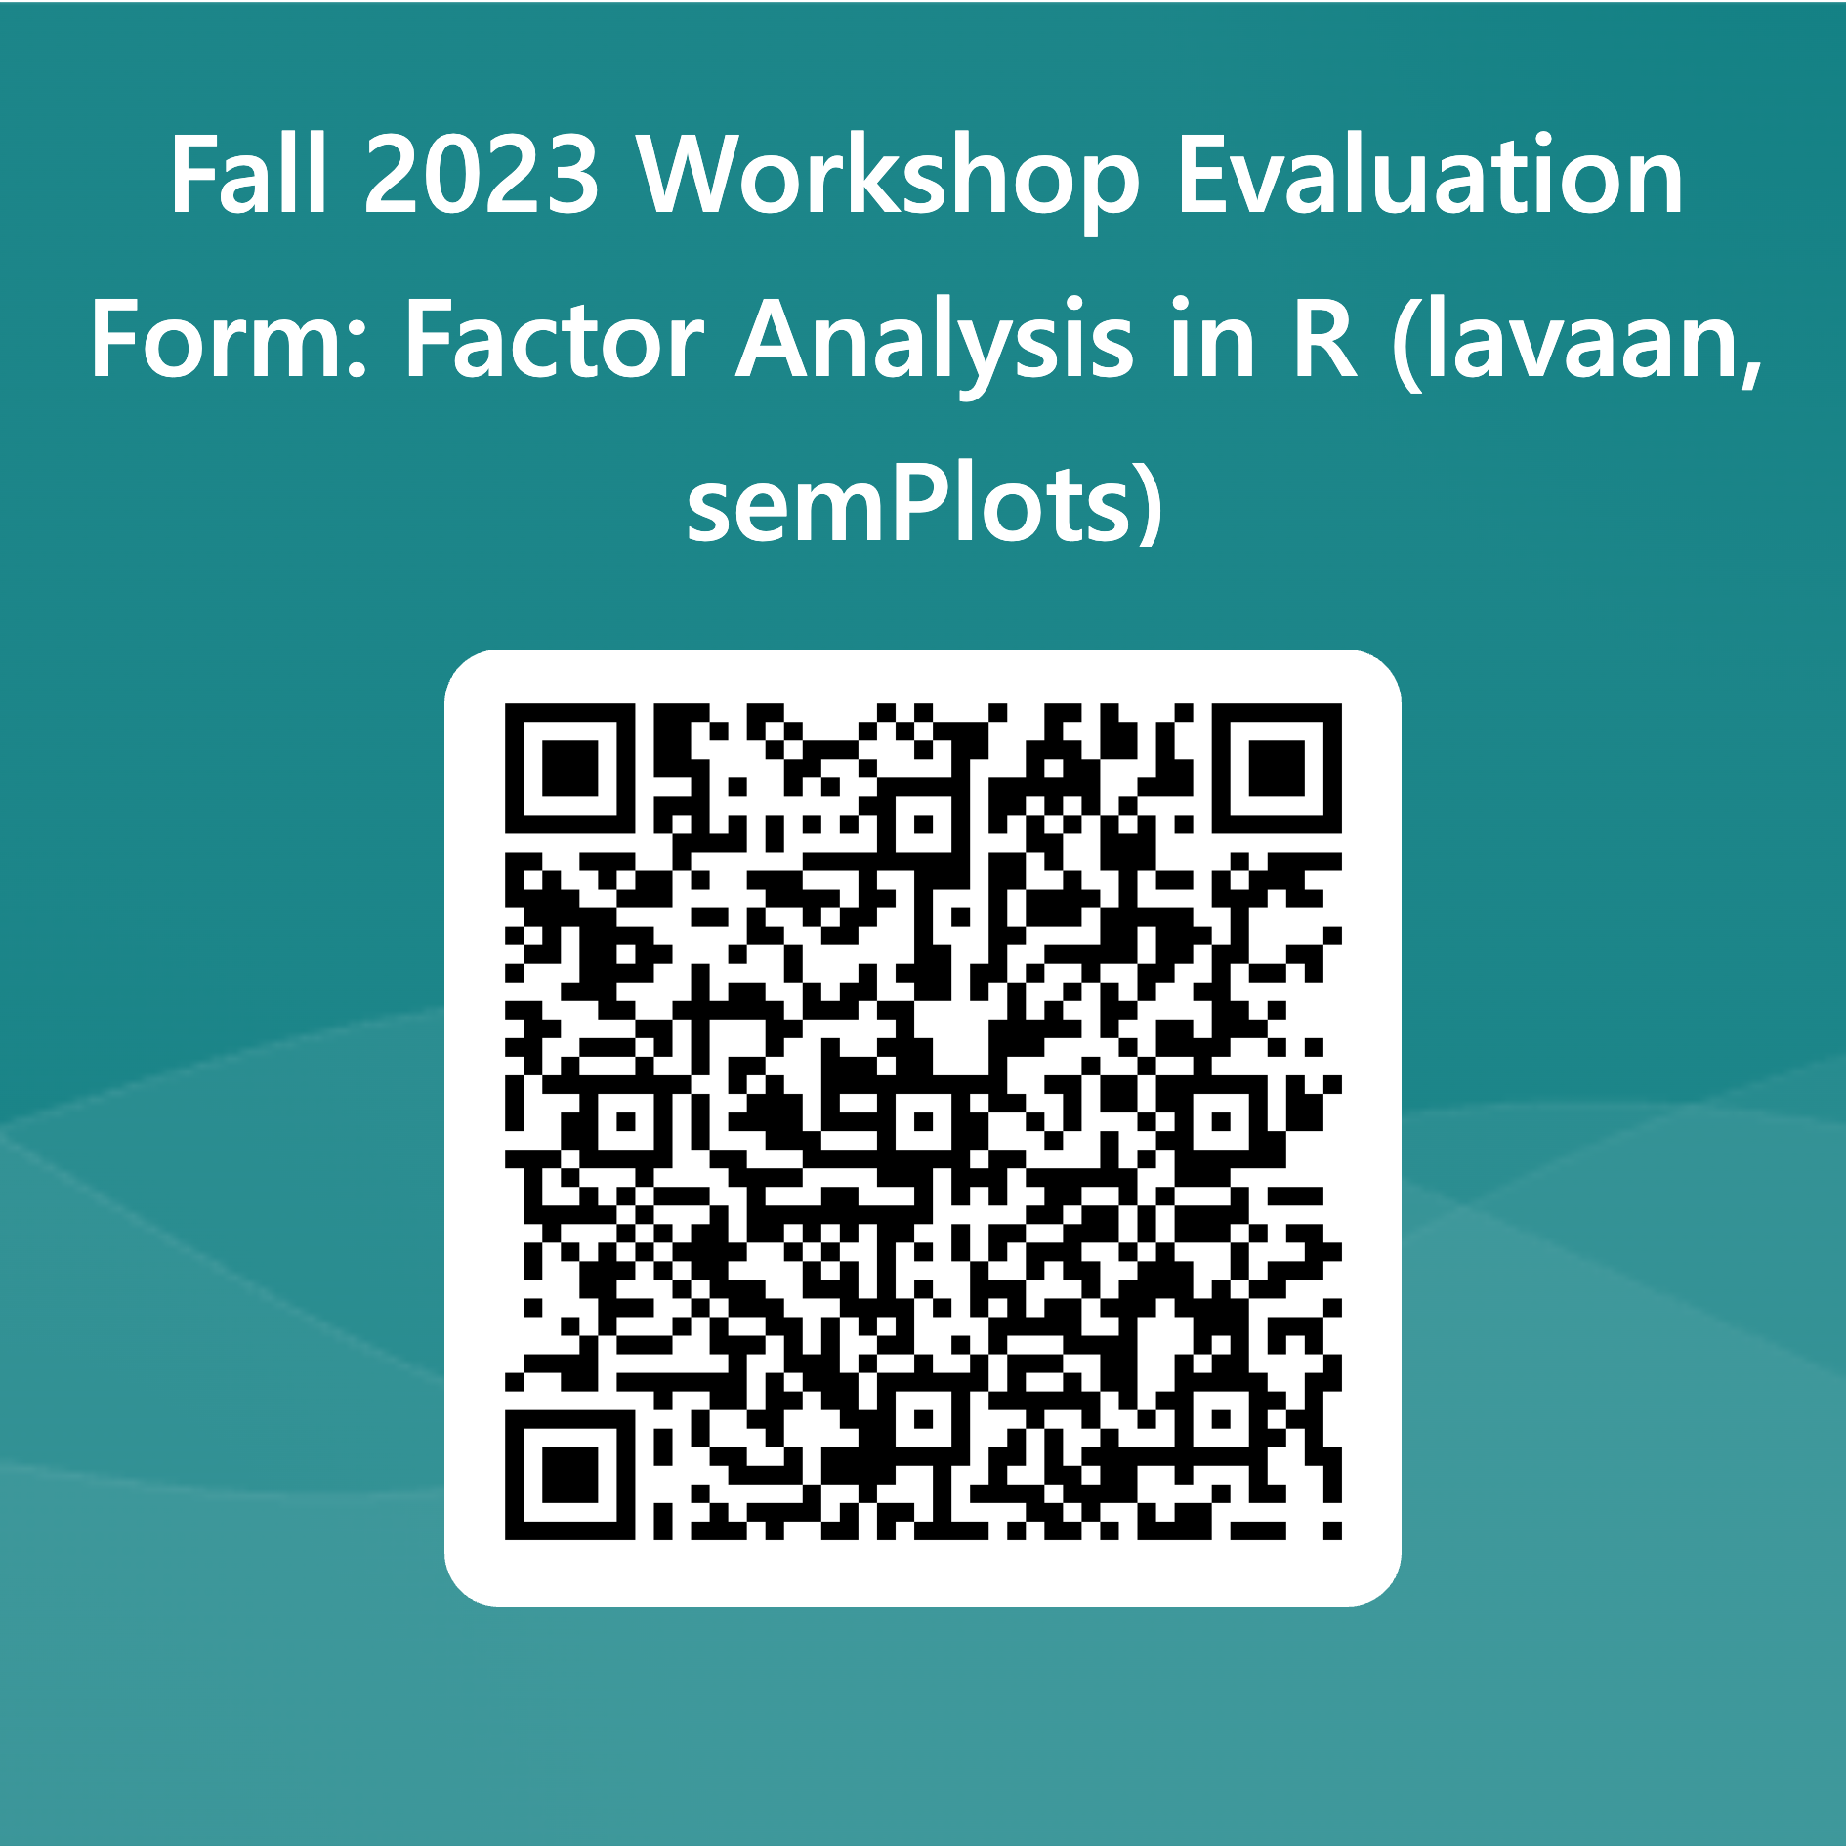
Notes:
https://forms.office.com/Pages/ResponsePage.aspx?id=ZkN-XZsbz0WOebFLJ99G4SUXqdLlghJDhzZ5bd0gLPtUQUVYVVg1TjkzU0pQWFU4WTYxQVBKQkYxTi4u

Slide 11
Q&A

